Slide 1

Computing Landscape “computing technology is changing.”
Sanjeeva Perera - Senior Academic Fellow
Department of Computer Systems Engineering,
Faculty of Computing

Slide 2
Attendance https:

Slide 3
COMPUTING LANDSCAPE

Slide 4
Aim of the Lecture
You will be a professional who works in an area related to Computing
Be effective by knowing the Landscape of your domain
How and in Which ways your profession impacts the society

Slide 5
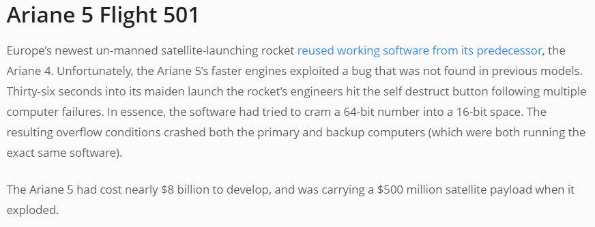

Slide 6
Agenda
History of Computers
Today’s Computing Landscape
Social, Legal, Ethical and Environmental Aspects
Discussion

Slide 7
History of Computers
Pre-Generation (Before ‘40s) – Mechanical
First Generation (‘40s) – Vacuum Tube
Second Generation (‘50s) – Transistor
Third Generation (‘60s) – Integrated Circuits
Fourth Generation (‘70s) – Micro-processors
Fifth Generation (‘00) – AI

Slide 8
History of Computers
Rapid advancement
Components
CPUs
Hard Disk
Memory
IO Devices

Slide 9
History of Computers
Rapid advancement
Computers
PCs, Workstations, Play stations
Notebooks
Hand held devices
Servers, Server farms and super computers
Embedded systems, wearable devices

Slide 10
Today’s Computing Landscape
Connectivity and Digital World
Internet
Mobile Phones
Emails
Social Networks
Online Education

Slide 11
Today’s Computing Landscape
Video sharing
Collaboration
E-commerce
Free information, Games etc.
Blogs
WWW

Slide 12
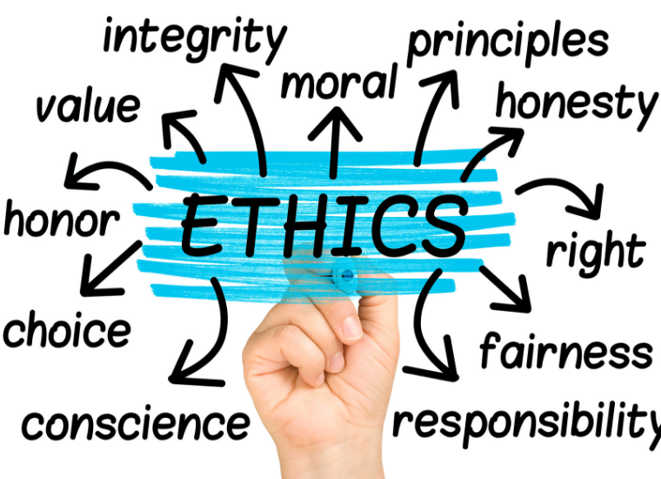
What is Ethics ?
Ethics, the discipline concerned with what is morally good and bad and morally right and wrong. The term is also applied to any system or theory of moral values or principles.

Slide 13
What Is a Code of Ethics?
A code of ethics is a guide of principles designed to help professionals conduct business honestly and with integrity. A code of ethics document may outline the mission and values of the business or organization, how professionals are supposed to approach problems, the ethical principles based on the organization's core values, and the standards to which the professional is held.
A code of ethics, also referred to as an "ethical code," may encompass areas such as business ethics, a code of professional practice, and an employee code of conduct.

Slide 14
Ethical Issues
Intellectual Property
Information Collection
Spam (unsolicited mail)
Differences between personal choices, business policies and Law

Slide 15
Legal Issues
Intellectual property and Licensing
Security vs privacy
Cyber crimes

Slide 16
Social Issues
Outsourcing and unemployment
Digital divide and Massive Open Online Courseware (MOOC)
Computerized customer service
Increased possibility of identity theft
Social media related issues: Cyberbullying (Cyberbullying is the use of technology to harass, threaten, embarrass, or target another person. Online threats and mean, aggressive, or rude texts, tweets, posts, or messages all count.)

Slide 17
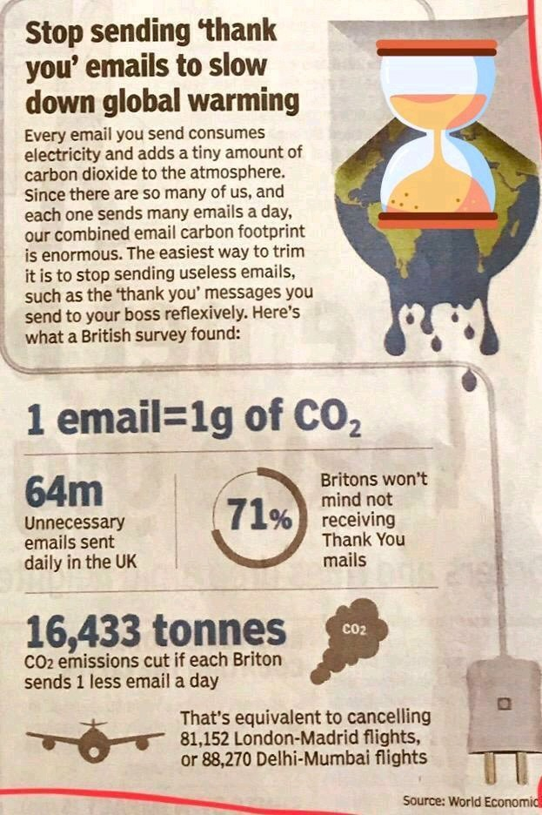
Environment Issues
E waste
Energy for manufacturing/operating
Hard copies of documents

Slide 18
Task 1: Critically evaluate following questions.
Some say that no technology is inherently good or evil; rather, any technology can be used for either good or evil purposes. Do you share this view?
“Thanks to a communications and software revolution, we are more ‘connected’ than ever before — by cell phone, email, and video conferencing — yet more disconnected than in the past from social interaction”. Do you agree?
What do you think are the main driving forces behind technology advances? Are you happy with the fast pace of the changes, or do you wish it were slower?
Do you tend to acquire new technological devices before or after the majority of your friends? What are the pros and cons of being an early/late adopter of a new technology?

Slide 19
Task 1 –Point 2 Nonverbal Communication (some times called “silent language”)
Defined as “nonword human response (such as gestures, facial expressions) and the perceived characteristics of the environment through which the human verbal and nonverbal messages are transmitted”.
Nonverbal communication - Video

Slide 20
Nonverbal Communication cont’d
Body Language and Paralanguage
Body Language
Facial expressions
Eyes
Feet
Hands
Posture
E.g. Good salespeople, advertisers capitalized on their knowledge of people’s eyes.

Slide 21
Nonverbal Communication cont’d
Paralanguage
Voice quality
Tone
Volume
Speech rate
Pitch
Nonfluencies (“ah”, “um”, or “uh”)
Laughing
Yawning

Slide 22
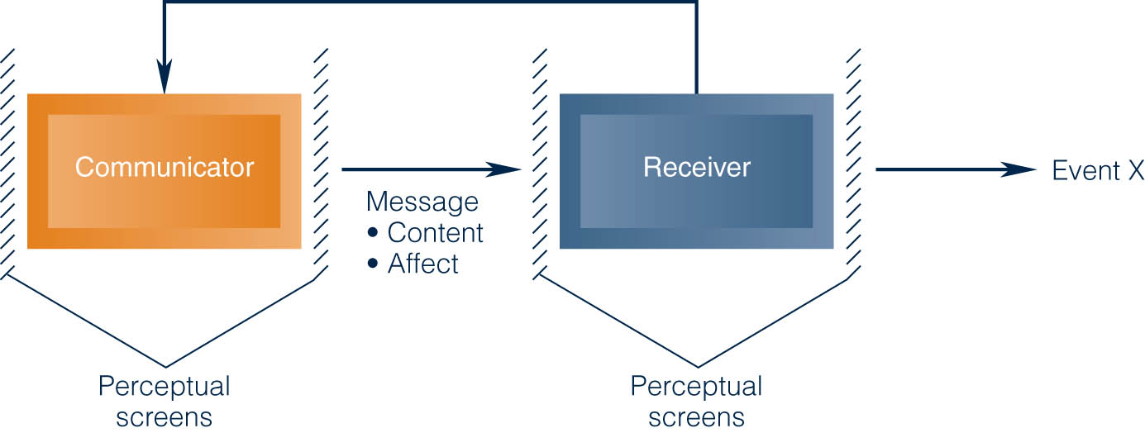
A Basic Interpersonal Communication Model

Slide 23
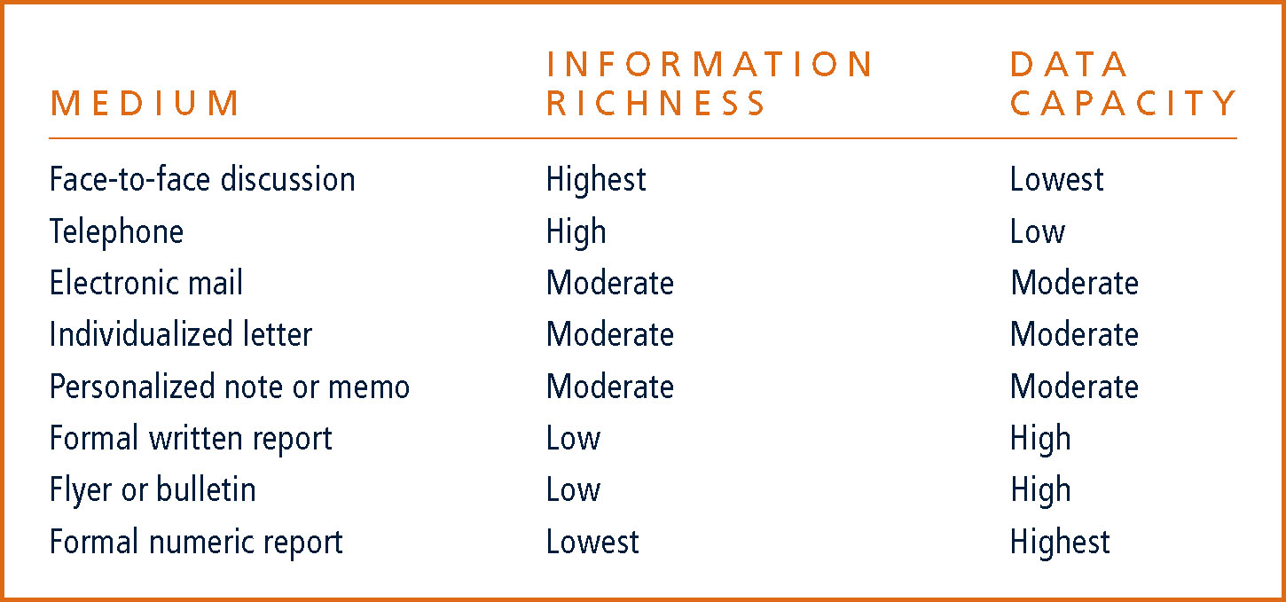
Communication Media: Information Richness and Data Capacity

Slide 24
Questions ?

